Slide 1
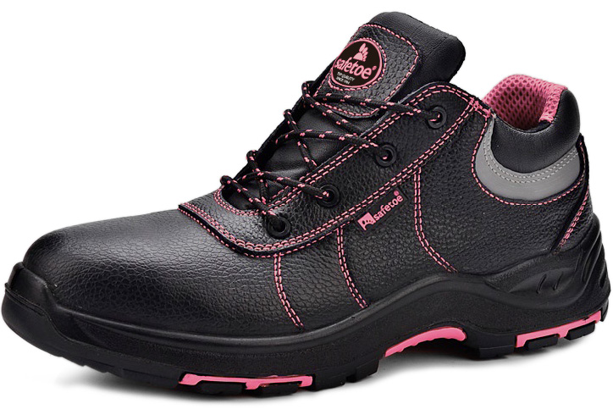










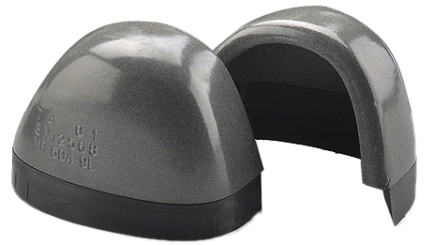
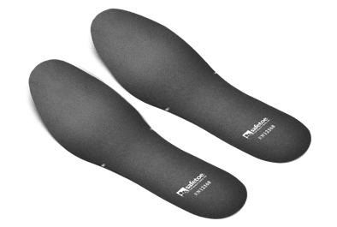




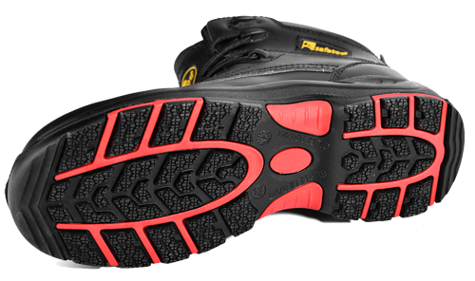
L-7147 Pink S3 SRC
SAFETY FOOTWEAR
Heavy Duty S3 Safety Shoes (LADY DESIGN）
Low Cut Lace-up Safety Shoes is made with Black Cow Leather and PU/Rubber Injection Outsole. It is designed as EN ISO 20345:2011 Quality with CE S3 category.
Upper : High Quality Water Resistant Cow Leather
Lining : Breathable Sandwich Air Mesh
Insole : Comfortable EVA Coated Mesh
Outsole : PU/Rubber Injection
Toecap : Steel Toecap
Penetration : Steel Midsole Plate
Size : EU 37-47#, UK 3-13#, US4-14#
CE EN ISO 20345:2011 S3 SRC
Application : Construction, Logistics, Mechanics, Glasses Installation, Factory Workshop, Garage etc
Steel Toecap Protection • AN1-EN12568
Stainless steel toe cap can reach 200 joules from falling or rolling objects. It is stronger than iron toe cap.
EXTRA WIDE
Steel Midsole Plate Protection • AN1-EN12568
Steel midsole plate, is zero-penetration resistant. It can resist 1100 newtons nail puncture from sharp objects. It is stronger and more flexible than normal iron plate.
Water Resistant Cow Leather Upper • CE EN ISO 20345:2011
High quality cow embossed leather with thickness 1.6-1.8mm. It is treated with water resistant coating to protect feet from raining workday. Tear strength is required 10% higher than Europe test requirement, to reach longer lifespan.
Heavy Duty PU/Rubber Outsole • CE EN ISO 20345:2011
The outsole is made with PU/Rubber material. The midsole is 45±5 degree hardness PU, which is soft and shock absorption. The outsole is natural rubber with 5%-10% nitrile, which can pass 300 ℃ heat resistant HRO test.

Slide 2
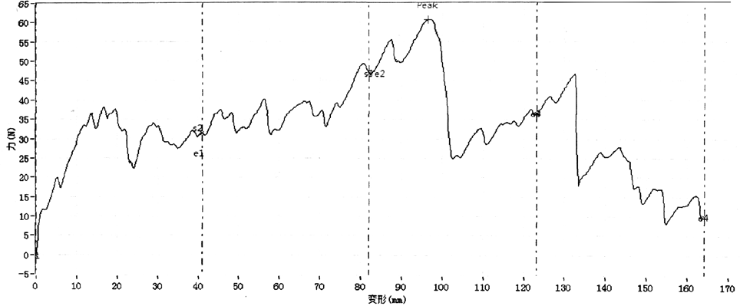
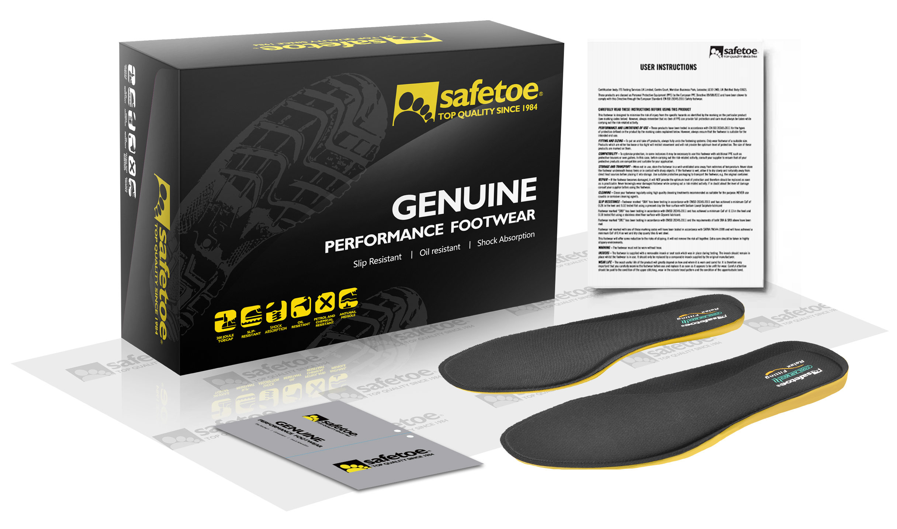
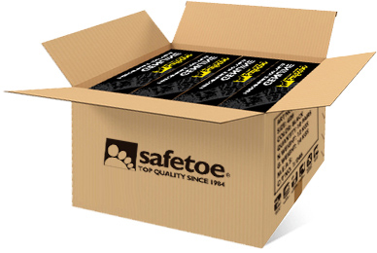
Sole Bonding Strength Test
EN ISO 20344:2011, 5.2 (Between Upper & Sole)
Average Test Result 5.8±5 (N/mm)
Leather Tear Strength ≥ | 120.0 Newtons
Leather Tensile Properties ≥ | 15.0 N/mm²
Lining Tear Strength ≥ | 15.0 N/mm
Bonding Strength ≥ | 4.0 N/mm
Upper, Lining & Bonding Strength Test Result
√ Protection With Slip Resistant (SRC) Result
Test Requirement : SRA (Eurotile 2+Nal S) Forward Heel Slip ≥0.28 & Forward Flat Slip: ≥0.32 SRB (Steel Floor+Glycerine) Forward Heel Slip ≥0.13 & Forward Flat Slip: ≥0.18
Standards : EN ISO 20344:2011(5.11) , SRC Means both SRA & SRB requirements are fulfilled.
√ Protection Against Heat Risk 300℃ Result
Test Requirement : The Outsole Did Not Melt & Did Not Develop Any Cracks When Bent Aound Mandrel
Standards : EN ISO 20344:2011(8.7). 300℃ HRO=Heat Resistant
√ Protection Resistant to Fuel Oil Result
Test Requirement : Change in Volume and Change in Hardness (Outsole) is No More Than +12%(*)
Standards : EN ISO 20344:2011(8.6.1)
SAFETOE Standard Package Instruction (Average 42# for Reference)
Shoes Weight : 1.1-1.2 KGS / Pair | Carton Weight : 12-13 KGS / Carton
1 Pair / Color Box , Dimensions : 32×21×12CM | 10 Pair / Carton , Dimensions : 62×43×33CM
PASS
PASS
PASS
User Instructions:
1.) RECOMMENDED TO USE : Construction, Logistics, Mechanics, Glasses Installation, Factory Workshop, Farming, Garden, Garage etc.
2.) LIMITATION TO USE: It is very important that footwear selected must be suitable for the right workplaces. The protection against risks or hazards which are not mentioned in this document is not warranted.
3.) FITTING & SIZE: All footwear are marked with standard size on tongue label. Some are with different size comparation, such as EU size, UK size, US size etc. Please wear footwear in a suitable size.
Footwear which are too loose or too tight may not provide optimum level of protection.
4.) STORAGE: Keep the footwear in its original packaging, under ordinary temperature, non-humidity conditions and in clean, covered and ventilated premises.
5.) CLEANING: Clean footwear regularly by high quality cleaning treatments recommended as suitable for the purpose. Don't use caustic or corrosive cleaning agents.

